Slide 1
VOYAGE VISTA : ILLUMINATING INSIGHTS FROM UBER EXPENDITIONARY ANALYSIS :

Slide 2
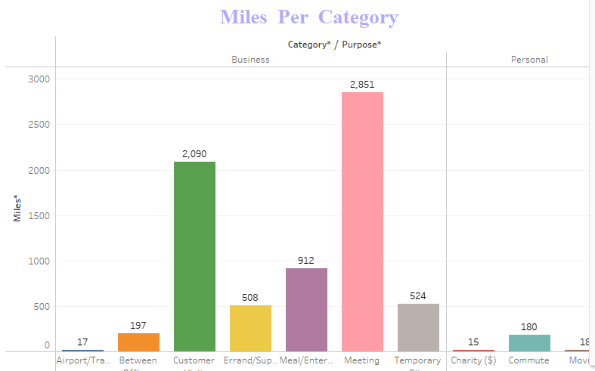
MILES COVERED PER CATEGORY AND PURPOSE ANALYSIS :

Slide 3
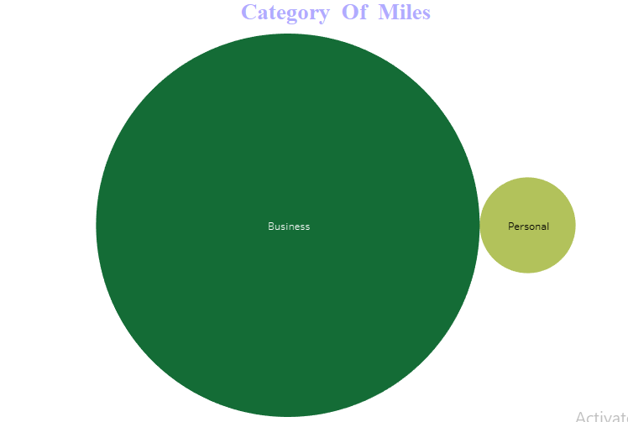
MILES COVERED IN CATEGORY ANALYSIS:

Slide 4
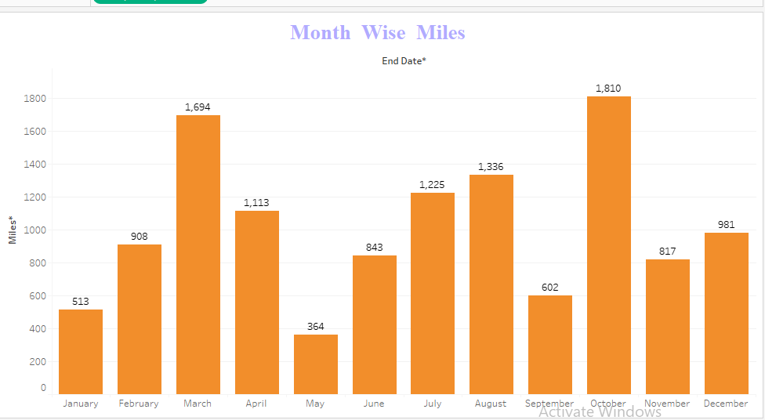
MONTH WISE UBER MILES ANALYSIS :

Slide 5
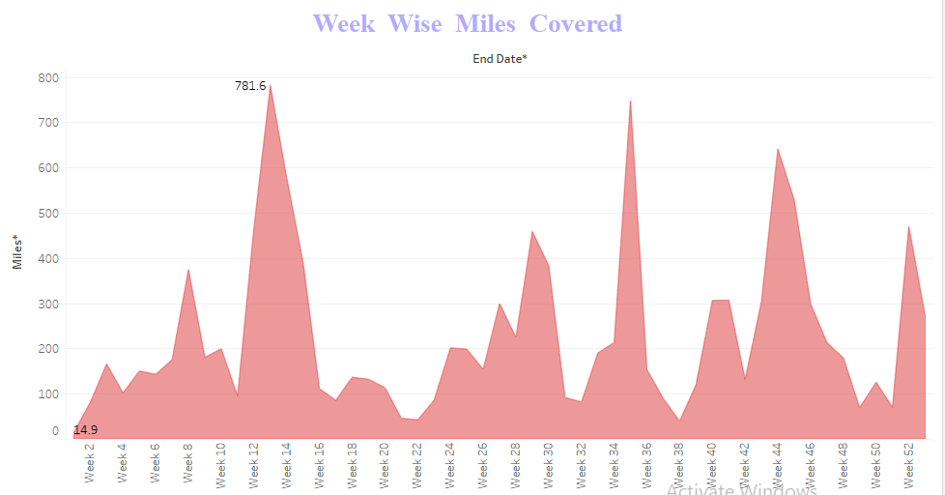
WEEK WISE UBER MILES ANALYSIS :

Slide 6
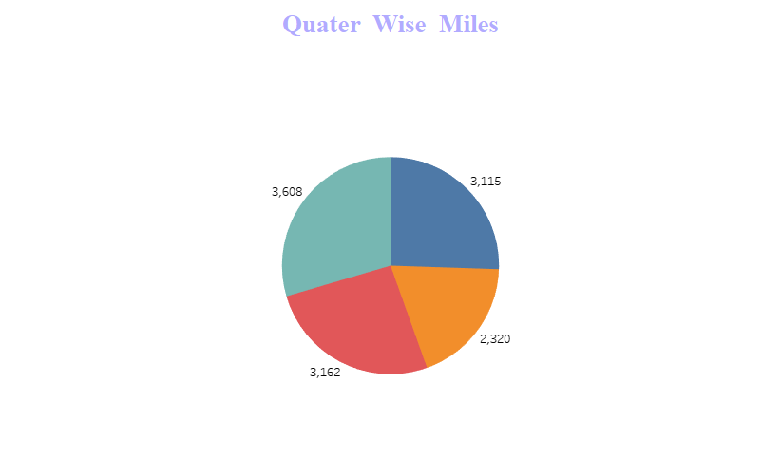
QUARTER WISE MILES :

Slide 7
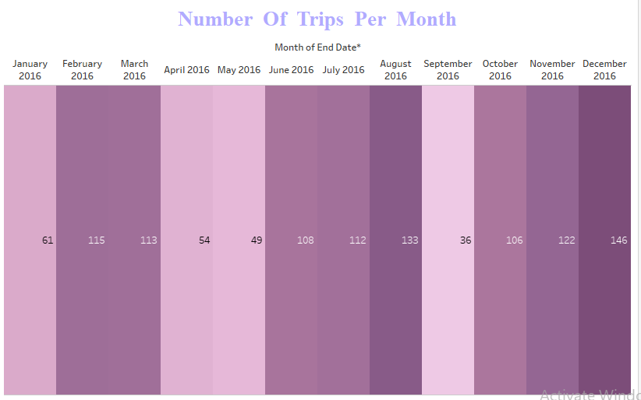
MONTH WISE UBER TRIPS ANALYSIS :

Slide 8
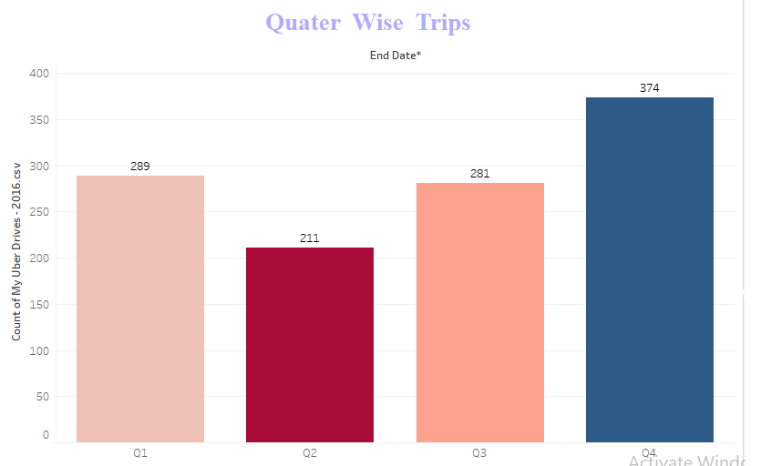
QUARTER WISE UBER TRIPS ANALYSIS :

Slide 9
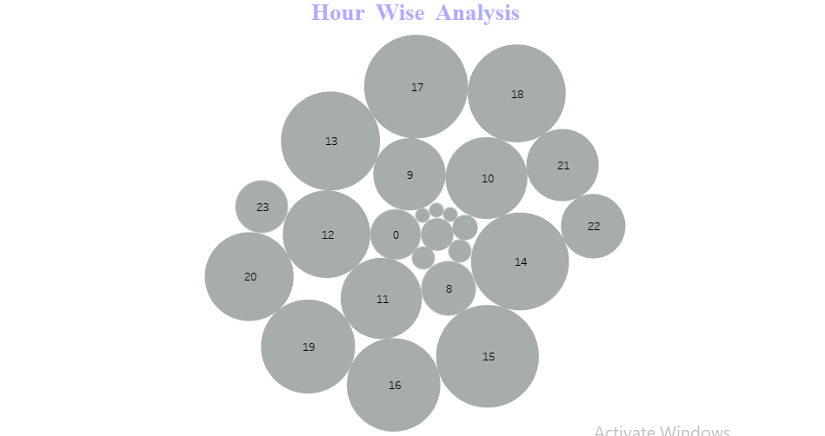
HOUR WISE UBER TRIPS ANALYSIS :

Slide 10
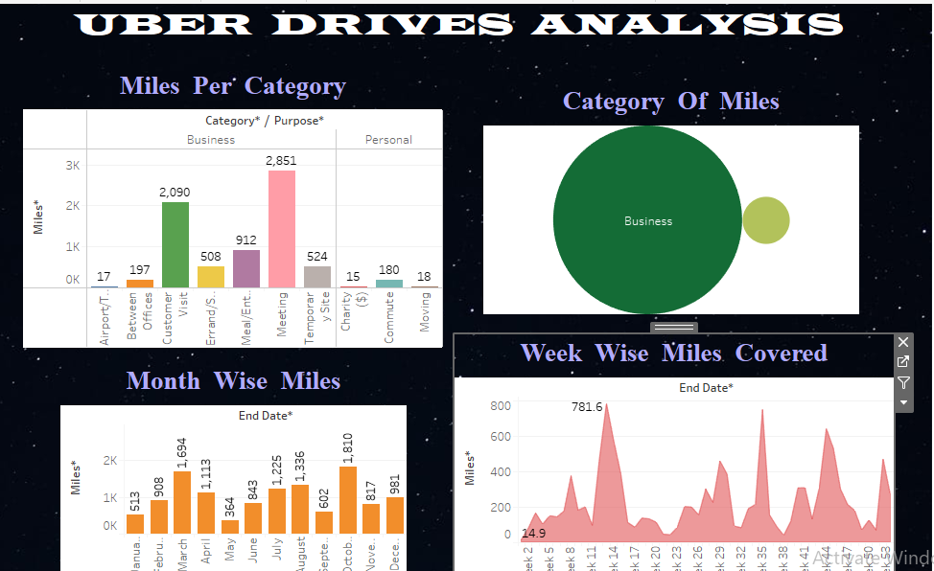
DASHBOARD – 1 :

Slide 11
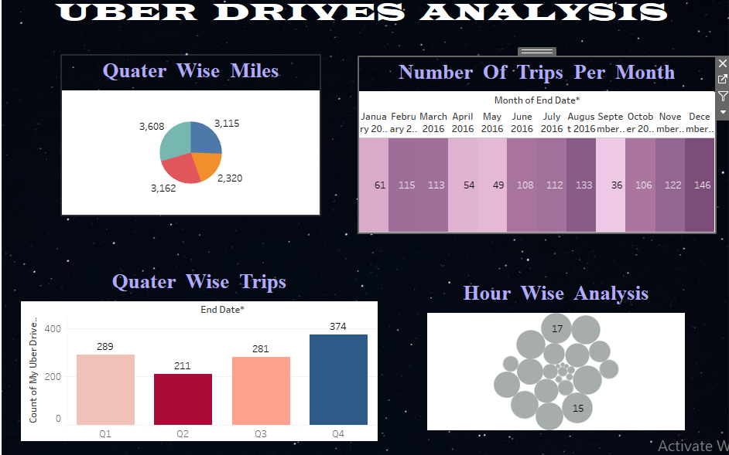
DASHBOARD – 2 :

Slide 12
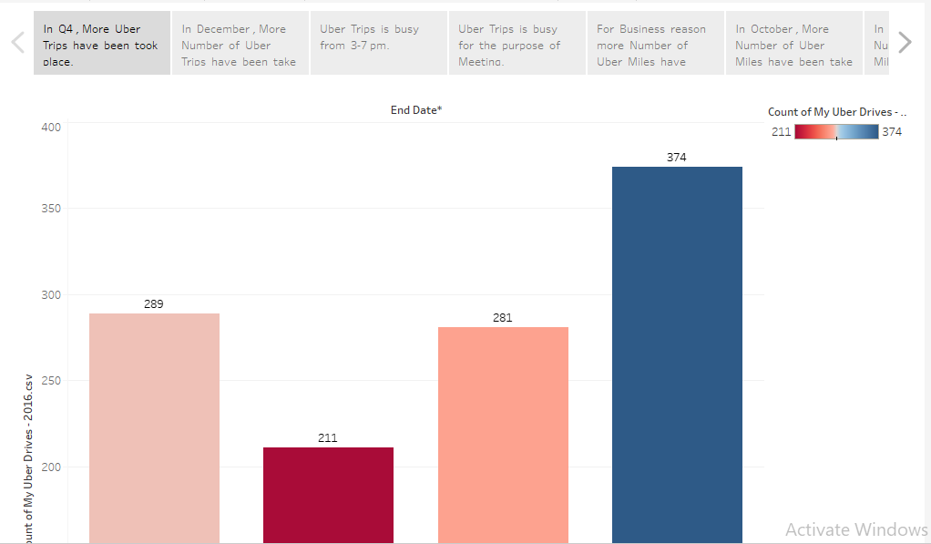
STORY – 1 :

Slide 13
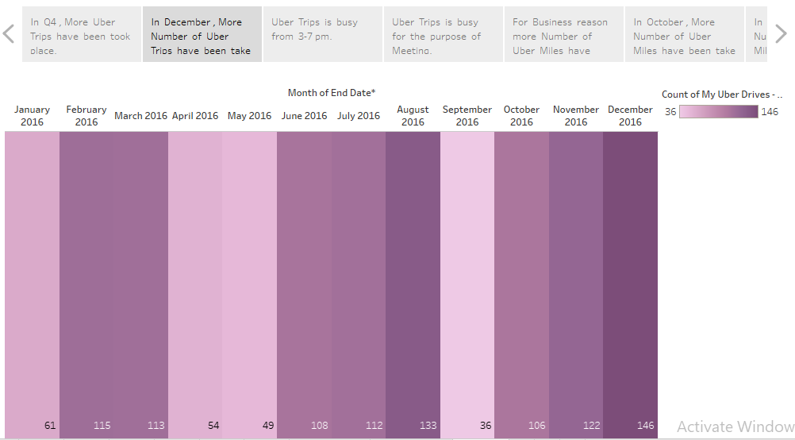
STORY - 2 :

Slide 14

STORY - 3 :

Slide 15
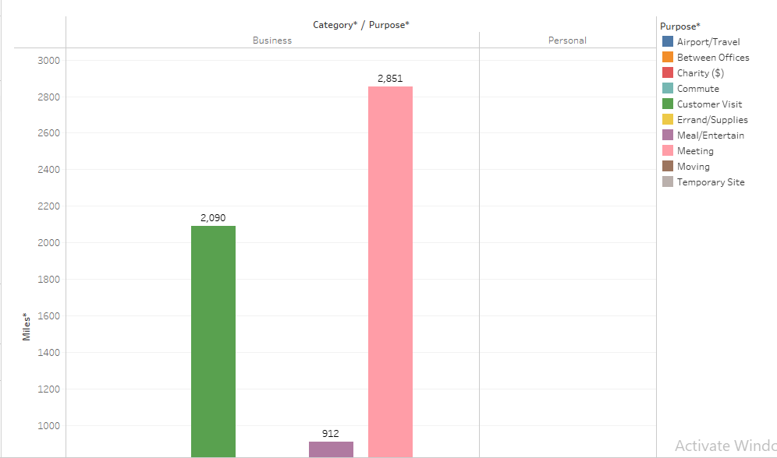
STORY – 4 :

Slide 16

STORY - 5 :

Slide 17
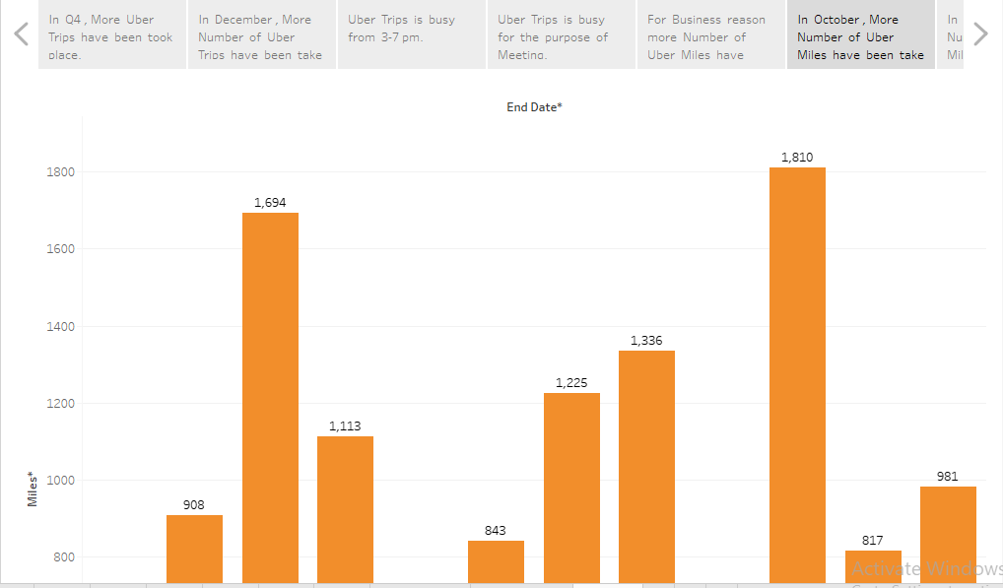
STORY - 6 :

Slide 18
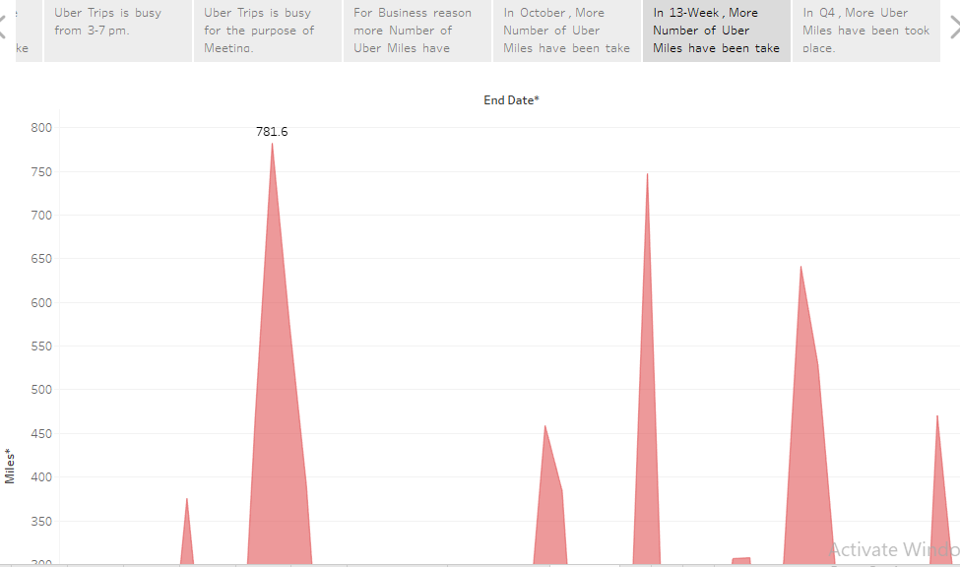
STORY - 7 :

Slide 19
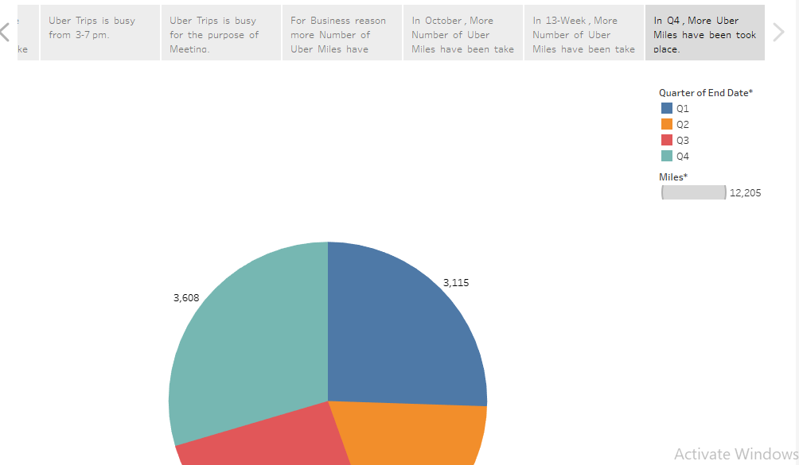
STORY - 8 :

